Slide 1
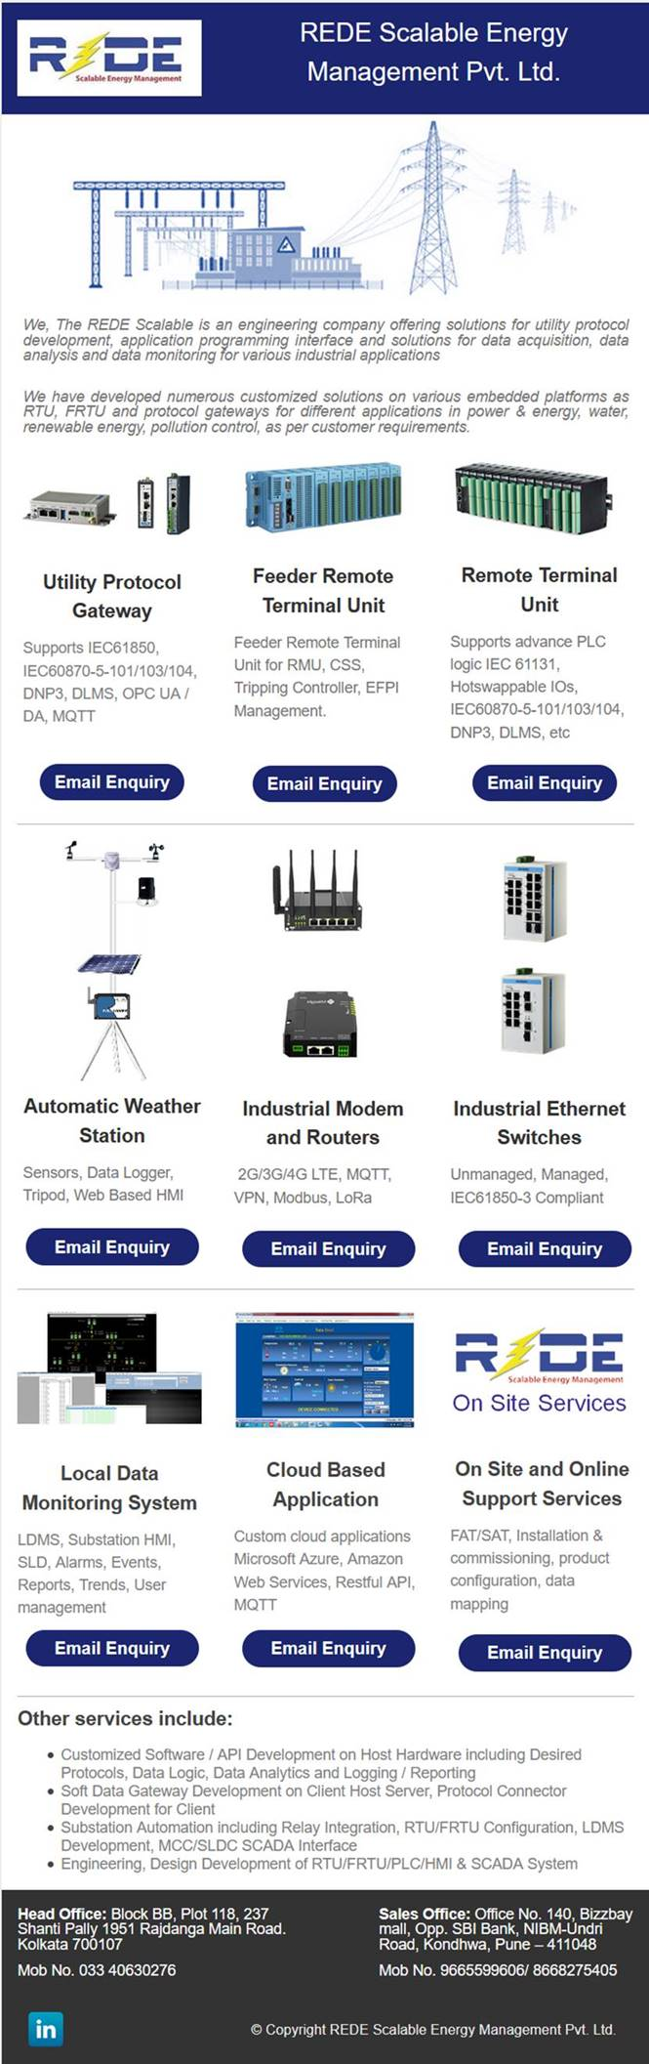

Slide 2


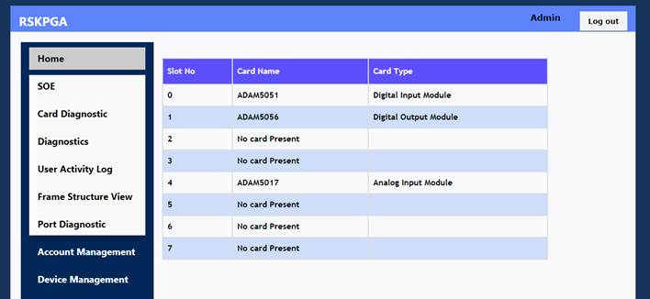





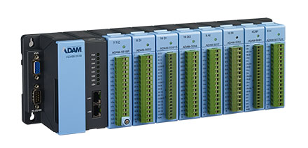



Feeder Remote Terminal Unit for Smart Grids
Powered by
REDE Scalable has developed a powerful and modular feeder remote terminal unit (FRTU) based on the proven Advantech Hardware. The FRTU shall be installed at Ring Main Units (RMUs) or at Compact Substations, The FRTU system monitors & controls all the sub-station equipment Like circuit breakers, relays, isolators that are prevalent in any electricity distribution system and all the parameters of all incoming and outgoing feeders on real-time.
Powerful and Reliable Data Management Platform
FRTU supports most commonly-used I/O and interfaces. This enables a wide range of applications across vertical markets. Also, with its modular design, users can extend the I/O with additional I/O rack selections to fulfill various scalability.
Protocol Conversion Capability Empowers Power Transmission and Distribution Efficiency
Feeder Remote Terminal Unit (FRTU) for System Average Interruption Frequency Index (SAIFI) / System Average Interruption Duration Index (SAIDI) measurements are required at primary electricity substations for acquiring status data from multiple input devices. The FRTU can convert several different protocols to improve the efficiency of power transmission and distribution.
Self-healing Technology for Easy Management of Smart Grids
Remote monitoring, diagnosis, and built-in self-healing features mean developers can create more innovative programs and value-added services to respond to the rapidly changing IoT landscape.
REDE Scalable Energy Management Pvt Ltd

Slide 3
FRTU - Hardware & Software Specifications
Hardware Specifications
CPU | Cortex A8 600MHz
Backup Memory | 128kb
Memory | DDR3L 512MB
Data Storage | SD card
Communication interface | COM1: Screw terminal (2-pin RS-232/485)
 | COM2: Screw terminal (RS-485)
 | COM3: Screw terminal (RS-485)
 | COM4: DB9-M (RS-232/485)
 | 2 x RJ45 (IPv4/IPv6)
 | 2 x USB 2.0 host
Wireless Connectivity | LTE (optional)
 | WLAN (WiFi) / Bluetooth (optional)
Display Interface | VGA
Power Input | 10 ~ 30 VDC
Installation | DIN-rail / wall mount
Operating Temperature | -40~70°C
Certification | CE / FCC
Software Features
Security | User level authentication Secure web access HTTPS SSL, SSH, white list
Data Service | Remote FTP server
Programming | Supports PLC programming as IEC61131-3
Support Protocols | IEC-60870-5-104 slave
 | DNP 3.0 Master & slave
 | MODBUS RTU master
 | MODBUS TCP master
 | IEC-60870-5-103 master
 | IEC-60870-5-101 master
 | IEC-61850 client
Protocol Analyzer (Online Protocol Frame Structure Monitoring and Download) | IEC-60870-5-104 slave
 | MODBUS RTU master
 | MODBUS TCP master
 | IEC-60870-5-103 master
 | IEC-60870-5-101 master
 | IEC-61850 client
Master Communication | Supports up to 8 x IEC-104 SCADA master parallel communication
Web Based Management | Device IP configuration
 | Master / slave protocol frame structure
 | User authentication
 | Online device configuration
 | Firmware upload to RTU
 | Time synchronization settings
 | IEC-104 Slave SOE monitoring and download
 | System tags monitoring
Diagnosis | Online port status
 | Online I/O channel status
 | Online system tags including CPU use, memory use
 | System tags and status mapping to IEC-104 SCADA
Event Manager | IEC-104 slave sequence of events (SOE)
SOE Capacity | 4K events with time stamp
VPN Tunnelling | OpenVPN
Time Synchronization | NTP and / or IEC-60870-5-104 slave
Time Sync Priority | Priority set up to 8 x IEC-104 master and / or 2 x NTP server
Configuration Options | Desktop utility and web-based remote configuration
REDE Scalable Energy Management Pvt Ltd

Slide 4
Feeder Remote Terminal Unit for Smart Grids
Supported IO Modules
Module | Part Code | Description
Analog IO | ADAM-5013 | 3-Ch RTD input
 | ADAM-5017 | 8-Ch AI
 | ADAM-5017P | 8-Ch AI with independent Input
 | ADAM-5017H | 8-Ch High-speed AI
 | ADAM-5017UH | 8-Ch Ultra high speed AI
 | ADAM-5018 | 7-Ch Thermocouple input
 | ADAM-5018P | 7-Ch Thermocouple input with independent Input
 | ADAM-5024 | 4-Ch AO
Digital IO | ADAM-5050 | 16-Ch DI/O
 | ADAM-5051 | 16-Ch DI
 | ADAM-5051D | 16-Ch DI w/LED
 | ADAM-5051S | 16-Ch Isolated DI w/LED
 | ADAM-5052 | 8-Ch DI
 | ADAM-5053S | 32-Ch Isolated DI (TTL)
 | ADAM-5055S | 16-Ch. Isolated DI/O w/LED
 | ADAM-5056 | 16-Ch DO
 | ADAM-5056D | 16-Ch DO w/LED
 | ADAM-5056S | 16-Ch Isolated DO w/LED
 | ADAM-5056SO | 16-Ch Iso. DO w/LED (source)
 | ADAM-5057S | 32-Ch Isolated DO (TTL)
Relay Output | ADAM-5060 | 6-Ch. Relay output
 | ADAM-5069 | 8-Ch Power Relay output w/ LED
Counter/Frequency | ADAM-5080 | 4-Ch Counter/Frequency
 | ADAM-5081 | 4-Ch High Speed Counter/Frequency
Serial IO | ADAM-5091 | 4-port RS232/422/485 with Isolated
CAN IO | ADAM-5095 | 2-port CAN Uni-PCI COMM Module w/I
Extension | ADAM-5101 | m-SATA/m.2 Storage Extension
 | ADAM-5101P | Mini PCIE Slot Extension
 | ADAM-5192 | 2-Ch USB to LAN
REDE Scalable Energy Management Pvt. Ltd.
Head Office: Block BB, Plot 118 Rajdanga Main Road, Kolkata - 700107 India
Sales Office: Office No. 140, Bizzbay mall, Opp. SBI Bank, NIBM-Undri Road, Kondhwa, Pune – 411048
REDE Scalable Energy Management Pvt Ltd

Slide 5
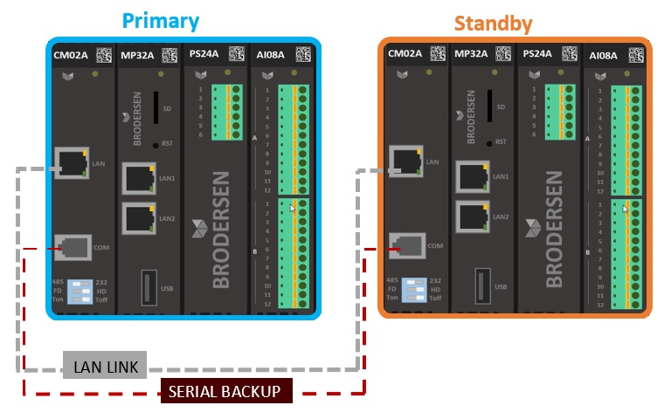


Remote Terminal Unit (RTU) for Smart Grids
Type 1: Full Redundancy in Two cabinets
Full redundancy – duplication of all hardware gives a high degree of redundancy. The two CPUs are connected with a LAN cable and a serial cable. The LAN cable replicates the data, and the serial cable is a live link in case of LAN cable failure. It is only necessary to program one CPU module – the program is automatically mirrored to the redundant CPU.
Advantage: the two systems can be in separate cabinets to minimize the risk in case of a power outage, fire, lightning etc.
I/O is completely redundant. In case of IO card failure, the redundant setup allows continuous operation without stop or dropout.
REDE Scalable Energy Management Pvt. Ltd.
Kolkata Office: Block BB, Plot 118 Rajdanga Main Road, Kolkata - 700107 India
Pune Office: Office No. 140, Bizzbay mall, Opp. SBI Bank, NIBM-Undri Road, Kondhwa, Pune – 411048
REDE Scalable Energy Management Pvt Ltd

Slide 6
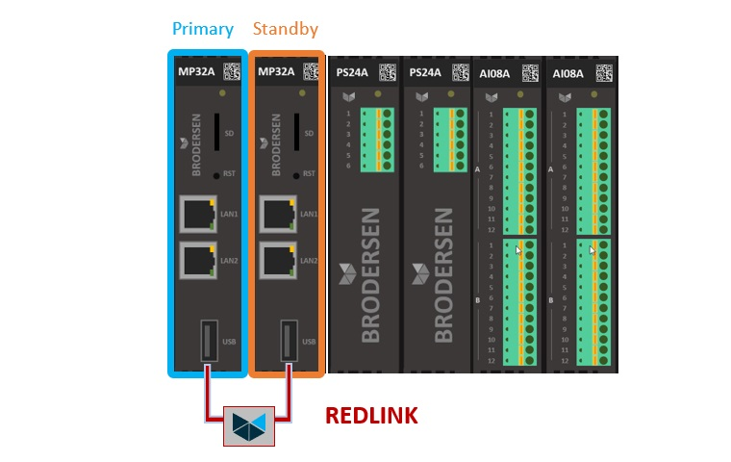
Remote Terminal Unit (RTU) for Smart Grids
Type 2: CPU Redundancy
The ‘classic’ redundant solution. It does not give the highest degree of protection against shutdown, but it is a well know layout, as most high-end PLC / RTUs can only handle this type of redundancy. This solution mirrors data via the backplane and through the REDLINK connection. It is only necessary to program one CPU module – the program is automatically mirrored to the redundant CPU.
Advantage: Easily added to existing solutions – just plug in the REDLINK and the system is redundant!
REDE Scalable Energy Management Pvt. Ltd.
Kolkata Office: Block BB, Plot 118 Rajdanga Main Road, Kolkata - 700107 India
Pune Office: Office No. 140, Bizzbay mall, Opp. SBI Bank, NIBM-Undri Road, Kondhwa, Pune – 411048
REDE Scalable Energy Management Pvt Ltd

Slide 7
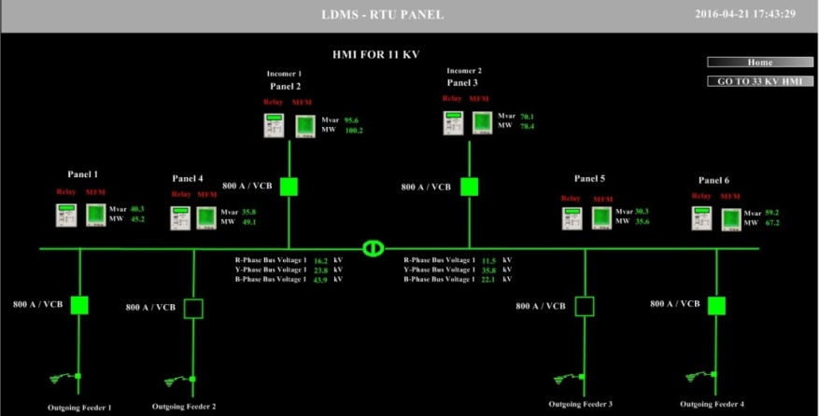
RS-SCADA
The main focus of RS-SCADA is real time monitoring and control of transmission and distribution of substation’s equipment remotely. From Intelligent electronic device (IED) to process equipment, RS-SCADA easily collects data through different protocols.
Features:
Support various protocol, IEC61850, DNP3, IEC-60870-5-101/104 and Modbus TCP-IP
SCADA based on Client / Server Architecture.
Multiple clients control and display..
Redundant architecture.
Sequence of events reporting with time stamped event data
Database in real time.
Trends in real-time and historical.
Security Level
Connection to different database systems.
Customize report generation
Simplified drawing tools
Libraries for the electrical and industrial
Filters and tools to print and export data in CSV/Excel/Pdf
REDE Scalable Energy Management Pvt. Ltd.
Kolkata Office: Block BB, Plot 118 Rajdanga Main Road, Kolkata - 700107 India
Pune Office: Office No. 140, Bizzbay mall, Opp. SBI Bank, NIBM-Undri Road, Kondhwa, Pune – 411048
REDE Scalable Energy Management Pvt Ltd

Slide 8

RSK-PGA: EMBEDDED SOFT SOLUTION
Customized Solution as per the requirement
Support different protocol Like:
IEC-61850
IEC-60870
MQTT
MODBUS RTU/TCP-IP
DNP 3.0
OPC-UA
OPC-DA
REDE Scalable Energy Management Pvt. Ltd.
Kolkata Office: Block BB, Plot 118 Rajdanga Main Road, Kolkata - 700107 India
Pune Office: Office No. 140, Bizzbay mall, Opp. SBI Bank, NIBM-Undri Road, Kondhwa, Pune – 411048
REDE Scalable Energy Management Pvt Ltd

Slide 9
Protocol Gateways
Utility Protocol Gateways
RSK-PGA protocol gateway supports all Important Protocol in Substation Automation System or Smart Grid System including
MODBUS RTU/TCP
IEC61850 client/server
IEC-60870-5-101/103/104
DLMS, DNP3, MQTT and OPC UA, etc.
User friendly configuration utility.
REDE Scalable Energy Management Pvt. Ltd.
Kolkata Office: Block BB, Plot 118 Rajdanga Main Road, Kolkata - 700107 India
Pune Office: Office No. 140, Bizzbay mall, Opp. SBI Bank, NIBM-Undri Road, Kondhwa, Pune – 411048
REDE Scalable Energy Management Pvt Ltd

